Slide 1

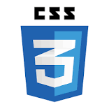

Welcome you all
Course: CSS

Slide 2
CSS Pseudo-classes
What is Pseudo-class
The CSS pseudo-classes allow you to style the dynamic states of an element such as hover, active and focus state, as well as elements that are existing in the document tree but can't be targeted via the use of other selectors without adding any IDs or classes to them, for example, targeting the first or last child elements.
A pseudo-class starts with a colon (:). Its syntax can be given with:
selector:pseudo-class { property: value; }
The following section describes the most commonly used pseudo-classes.

Slide 3
Anchor Pseudo-classes
Using anchor pseudo-classes links can be displayed in different ways:
These pseudo-classes let you style unvisited links differently from visited ones. The most common styling technique is to remove underlines from visited links.
a:link { color: blue; }
a:visited { text-decoration: none; }
a:hover { color: red; }
a:active { color: gray; }
hover applies when a user places cursor over the element, but does not select it.
active applies when the element is activated or clicked.

Slide 4
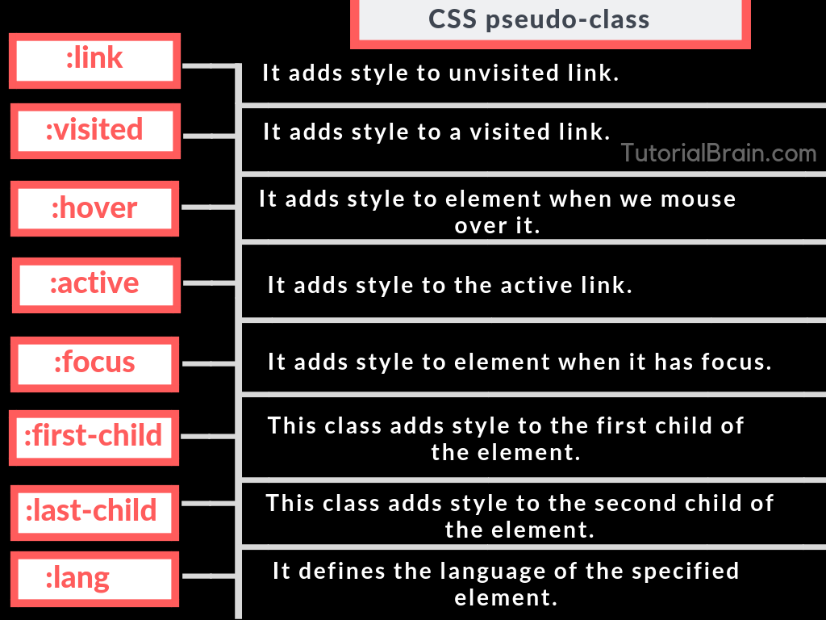

Slide 5
Styling Links with CSS
Links or hyperlinks are an essential part of a website. It allows visitors to navigate through the site. Therefore styling the links properly is an important aspect of building a user-friendly website.
See the tutorial on HTML links to learn more about links and how to create them.
A link has four different states — link, visited, active and hover. These four states of a link can be styled differently through using the following anchor pseudo-class selectors.
a:link — define styles for normal or unvisited links.
a:visited — define styles for links that the user has already visited.
a:hover — define styles for a link when the user place the mouse pointer over it.
a:active — define styles for links when they are being clicked.
You can specify any CSS property you'd like e.g. color, font, background, border, etc. to each of these selectors to customize the style of links, just like you do with the normal text.

Slide 6
a:link {
/* unvisited link */
color: #ff0000;
text-decoration: none;
border-bottom: 1px solid; }
a:visited { /* visited link */ color: #ff00ff; }
a:hover { /* mouse over link */ color: #00ff00; border-bottom: none; }
a:active { /* active link */ color: #00ffff; }
You can also target specific types of links, such as visited or hover links, by using the :visited and :hover pseudo-classes respectively:

Slide 7
CSS allows us to style links as desired. We can format text, by adding colors, background, increase size, etc.
CSS (Cascading Style Sheets) is a stylesheet language used for describing the presentation of a document written in a markup language. To apply a CSS style to a link (i.e., an <a> element), you can use the a selector and specify the desired styles.
For example:
a {
color: blue;
text-decoration: none;
}
This will make all links on the page blue and remove the underline.

Slide 8
The :first-child Pseudo-class
The :first-child pseudo-class matches an element that is the first child element of some other element. The selector ol li:first-child in the example below select the first list item of an ordered list and removes the top border form it.
ol{
padding: 0;
list-style: none;
}
ol li{
padding: 10px 0;
border-top: 1px solid #000000;
}
li:first-child {
border-top: none;
}

Slide 9
The :last-child Pseudo-class
The :last-child pseudo-class matches an element that is the last child element of some other element. The selector ul li:last-child in the example below select the last list item from an unordered list and removes the right border from it.
The :nth-child Pseudo-class
The CSS3 introduces a new :nth-child pseudo-class that allows you to target one or more specific children of a given parent element. The basic syntax of this selector can be given with :nth-child(N), where N is an argument, which can be a number, a keyword (even or odd), or an expression of the form xn+y where x and y are integers (e.g. 1n, 2n, 2n+1, …).

Slide 10
CSS Position
CSS Positioning Methods
Positioning elements appropriately on the web pages is a necessity for a good layout design. There are several methods in CSS that you can use for positioning elements. The following section will describe you these positioning methods one by one.
Static Positioning
A static positioned element is always positioned according to the normal flow of the page. HTML elements are positioned static by default. Static positioned elements are not affected by the top, bottom, left, right, and z-index properties.

Slide 11
.box {
padding: 20px;
background: #7dc765;
}
Relative Positioning
A relative positioned element is positioned relative to its normal position.
In the relative positioning scheme the element's box position is calculated according to the normal flow. Then the box is shifted from this normal position according to the properties — top or bottom and/or left or right.
.box { position: relative; left: 100px; }

Slide 12
Absolute Positioning
An absolutely positioned element is positioned relative to the first parent element that has a position other than static. If no such element is found, it will be positioned on a page relative to the 'top-left' corner of the browser window. The box's offsets further can be specified using one or more of the properties top, right, bottom, and left.
Absolutely positioned elements are taken out of the normal flow entirely and thus take up no space when placing sibling elements. However, it can overlap other elements depending on the z-index property value. Also, an absolutely positioned element can have margins, and they do not collapse with any other margins.
.box { position: absolute; top: 200px; left: 100px; }

Slide 13
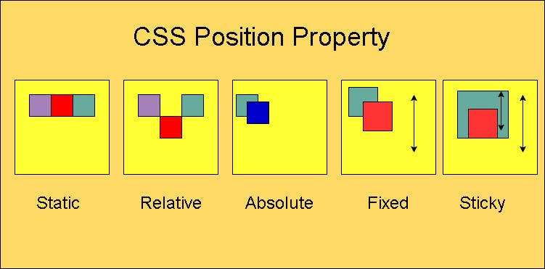

Slide 14
Fixed Positioning
Fixed positioning is a subcategory of absolute positioning.
The only difference is, a fixed positioned element is fixed with respect to the browser's viewport and does not move when scrolled.
.box {
position: fixed;
top: 200px;
left: 100px;
}

Slide 15
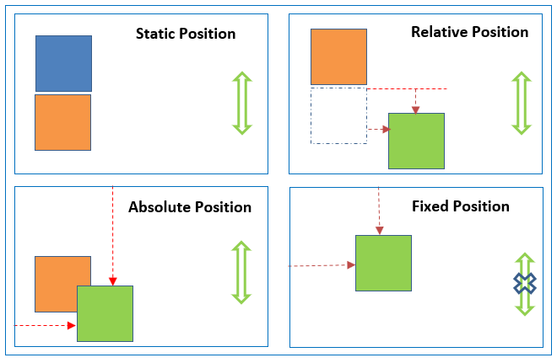

Slide 16
CSS Layers
Stacking Elements in Layers Using z-index Property
Usually HTML pages are considered two-dimensional, because text, images and other elements are arranged on the page without overlapping. However, in addition to their horizontal and vertical positions, boxes can be stacked along the z-axis as well i.e. one on top of the other by using the CSS z-index property. This property specifies the stack level of a box whose position value is one of absolute, fixed, or relative.
The z-axis position of each layer is expressed as an integer representing the stacking order for rendering. An element with a larger z-index overlaps an element with a lower one.
A z-index property can help you to create more complex webpage layouts. Following is the example which shows how to create layers in CSS.

Slide 17
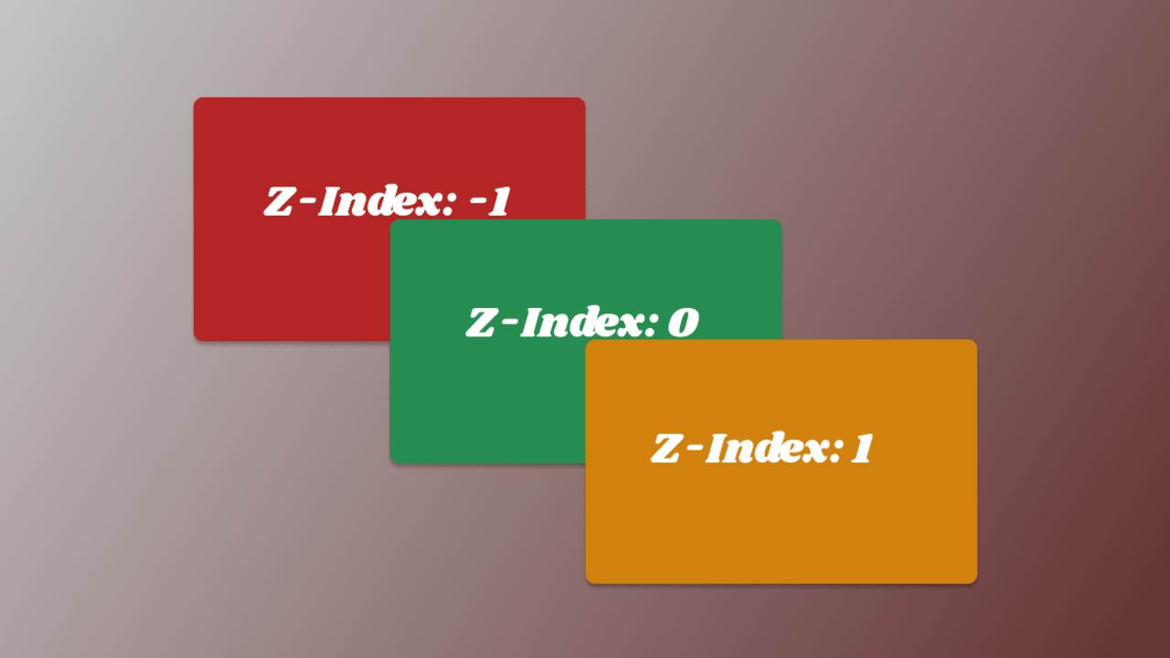

Slide 18
.box {
position: absolute;
left: 10px;
top: 20px;
z-index:0;
}

Slide 19
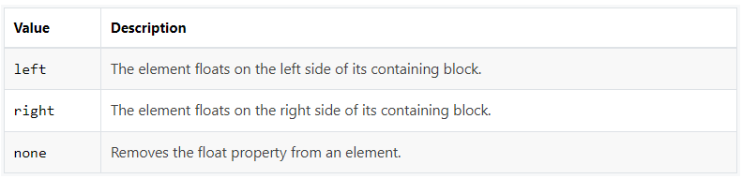
CSS Float
Floating Elements with CSS
You can float elements to the left or right, but only applies to the elements that generate boxes that are not absolutely positioned. Any element that follows the floated element will flow around the floated element on the other side.

Slide 20
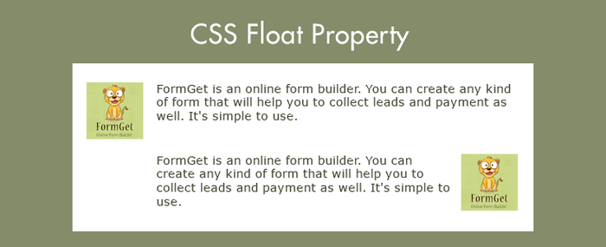

Slide 21
How Elements Float
A floated element is taken out of the normal flow and shifted to the left or right as far as possible in the space available of the containing element.
Other elements normally flow around the floated items, unless they are prevented from doing so by their clear property. Elements are floated horizontally, which means that an element can only be floated left or right, not up or down.
img { float: left; }

Slide 22
CSS Pseudo-elements
What is Pseudo-element
The CSS pseudo-elements allow you to style the elements or parts of the elements without adding any IDs or classes to them. It will be really helpful in the situations when you just want to style the first letter of a paragraph to create the drop cap effect or you want to insert some content before or after an element, etc. only through style sheet.
CSS3 introduced a new double-colon (::) syntax for pseudo-elements to distinguish between them and pseudo-classes. The new syntax of the pseudo-element can be given with:
selector::pseudo-element { property: value; }

Slide 23
The ::first-line Pseudo-element
The ::first-line pseudo-element applies special style to the first line of a text.
The style rules in the following example formats the first line of text in a paragraph. The length of first line depends on the size of the browser window or containing element.
CSS
p::first-line {
color: #ff0000;
font-variant: small-caps;
}

Slide 24
The ::first-letter Pseudo-element
The ::first-letter pseudo-element is used to add a special style to the first letter of the first line of a text. The style rules in the following example formats the first letter of the paragraph of text and create the effect like drop cap.
<!DOCTYPE html>
<html lang="en">
<head>
<meta charset="utf-8">
<title>Example of CSS ::first-letter Pseudo-element</title>
</head>
<body>
<p>The first letter of this paragraph is styled differently.</p>
</body>
</html>
CSS
p::first-letter {
color: #ff0000;
font-size: xx-large;
}

Slide 25
The ::before and ::after Pseudo-element
The ::before and ::after pseudo-elements can be used to insert generated content either before or after an element's content. The content CSS property is used in conjunction with these pseudo-elements, to insert the generated content.
This is very useful for further decorating an element with rich content that should not be part of the page's actual markup. You can insert regular strings of text or an embedded object such as image and other resources using these pseudo-elements.
h1::before {
content: url("/examples/images/marker-left.gif");
}
h1::after {
content: url("/examples/images/marker-right.gif");
}

Slide 26
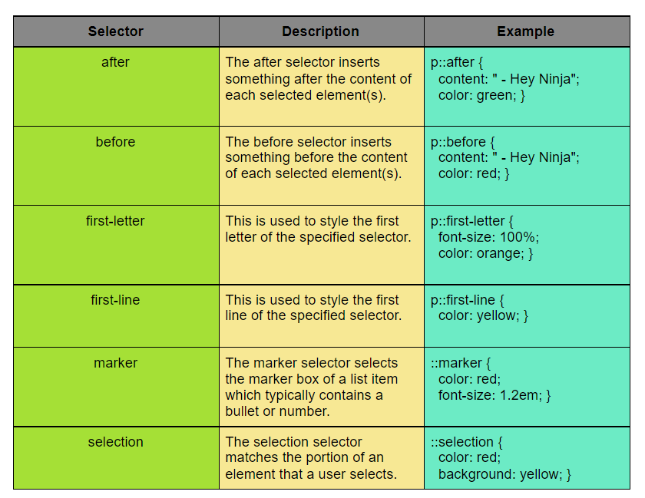

Slide 27

OPACITY
The opacity property specifies the opacity/transparency of an element.
The opacity property can take a value from 0.0 - 1.0. The lower the value, the more transparent:
img{
opacity:0.6
}

Slide 28

img{
opacity:1
}

Slide 29

img{
opacity:0.3
}

Slide 30
CSS OVERFLOW
The CSS overflow property controls what happens to content that is too big to fit into an area.
There may be a situation when the content of an element might be larger than the dimensions of the box itself. For example given width and height properties did not allow enough room to accommodate the content of the element.
CSS overflow property allowing you to specify whether to clip content, render scroll bars or display overflow content of a block-level element.
This property can take one of the following values: visible (default), hidden, scroll, and auto. CSS3 also defines the overflow-x and overflow-y properties which allow for independent control of the vertical and horizontal clipping.

Slide 31
The overflow property specifies whether to clip the content or to add scrollbars when the content of an element is too big to fit in the specified area.
The overflow property has the following values:
visible - Default. The overflow is not clipped. The content renders outside the element's box
hidden - The overflow is clipped, and the rest of the content will be invisible
scroll - The overflow is clipped, and a scrollbar is added to see the rest of the content
auto - Similar to scroll, but it adds scrollbars only when necessary

Slide 32
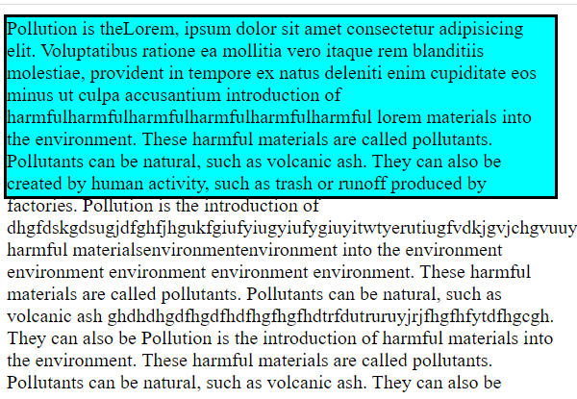
overflow-x and overflow-y
The overflow-x and overflow-y properties specifies whether to change the overflow of content just horizontally or vertically (or both):
overflow-x specifies what to do with the left/right edges of the content.
overflow-y specifies what to do with the top/bottom edges of the content.
overflow:visible;

Slide 33
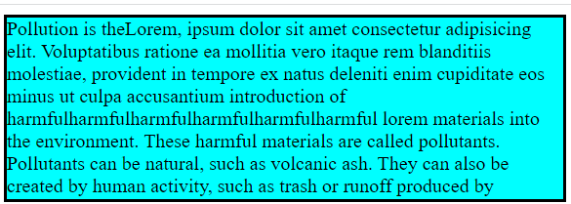
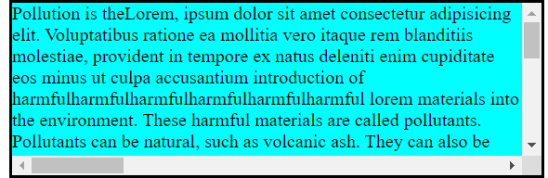
overflow:hidden;
overflow:scroll;

Slide 34
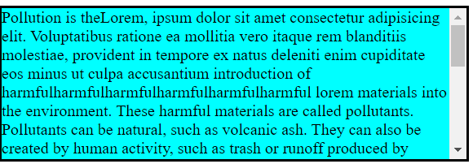
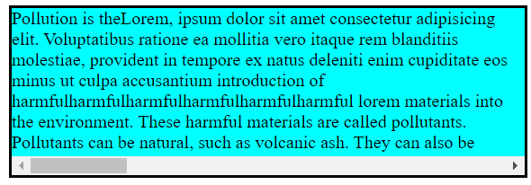
overflow:X hidden;
overflowY:scroll;
overflow:Y hidden;
overflow:scroll;

Slide 35
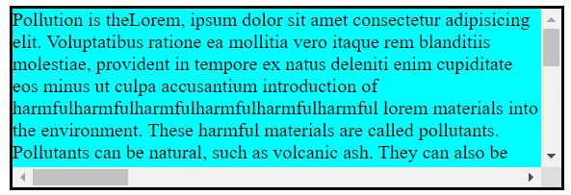
overflow:X scroll;
overflow:Y scroll;

Slide 36
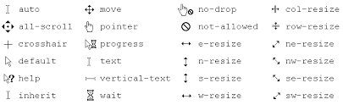
cursor
The cursor CSS property sets the mouse cursor, if any, to show when the mouse pointer is over an element.
The cursor setting should inform users of the mouse operations that can be performed at the current location, including: text selection, activating help or context menus, copying content, resizing tables, and so on

Slide 37
value Description
alias The cursor indicates an alias of something is to be created
all-scroll The cursor indicates that something can be scrolled in any direction
auto Default. The browser sets a cursor
cell The cursor indicates that a cell (or set of cells) may be selected
col-resize The cursor indicates that the column can be resized horizontally
context-menuThe cursor indicates that a context-menu is available
copy The cursor indicates something is to be copied
crosshair The cursor render as a crosshair

Slide 38
Value Description
default The default cursor
e-resize The cursor indicates that an edge of a box is to be moved right (east)
ew-resize Indicates a bidirectional resize cursor
grab The cursor indicates that something can be grabbed
grabbing The cursor indicates that something can be grabbed
help The cursor indicates that help is available
move The cursor indicates something is to be moved

Slide 39
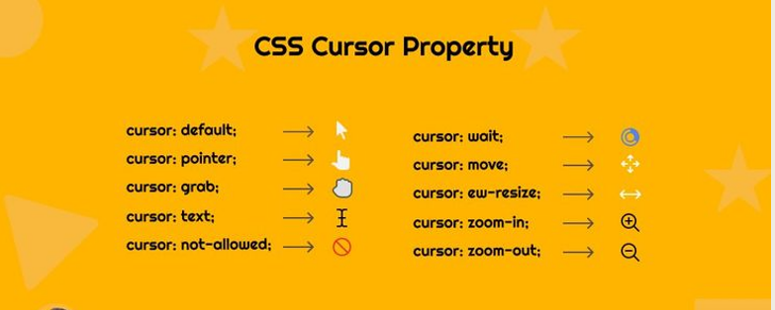

Slide 40


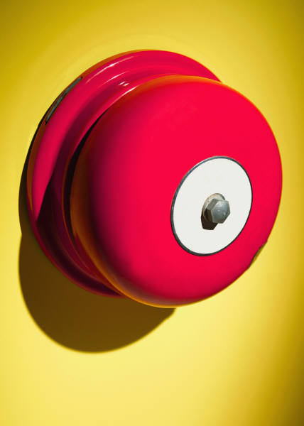
Thank You

